Slide 1
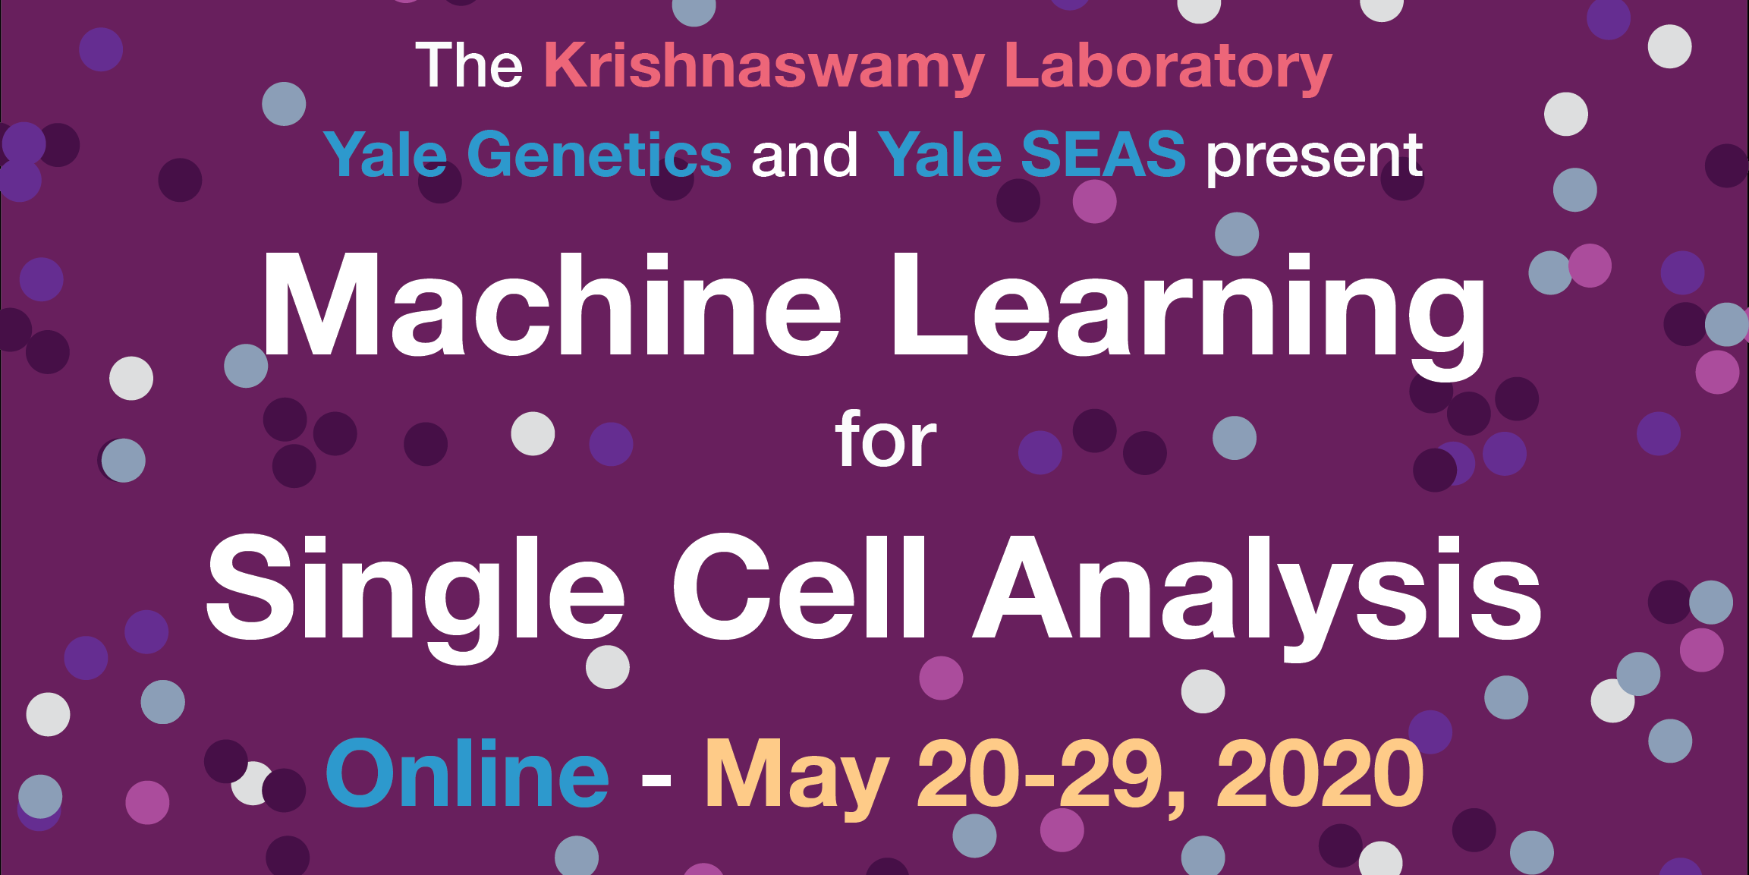

Slide 2
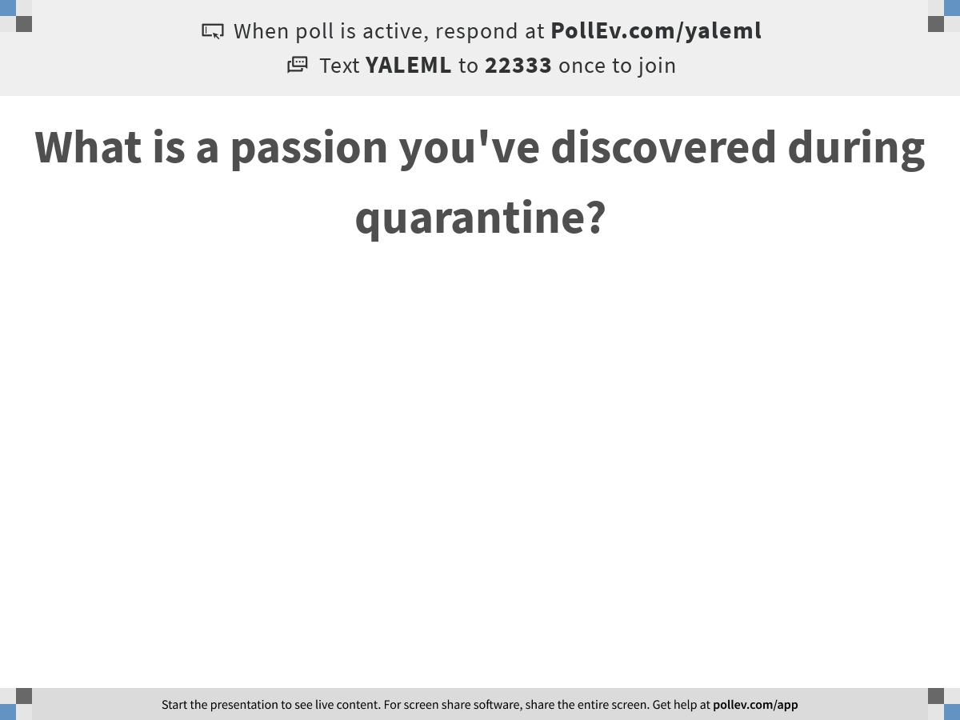
Notes:
What is a passion you've discovered during quarantine?
https://www.polleverywhere.com/free_text_polls/ji3e941oREI1Wky1RJ2Dx

Slide 3

Recap from Day 2
Notes:
TA introduction
Talk about not teaching code (not a programming workshop)

Slide 4
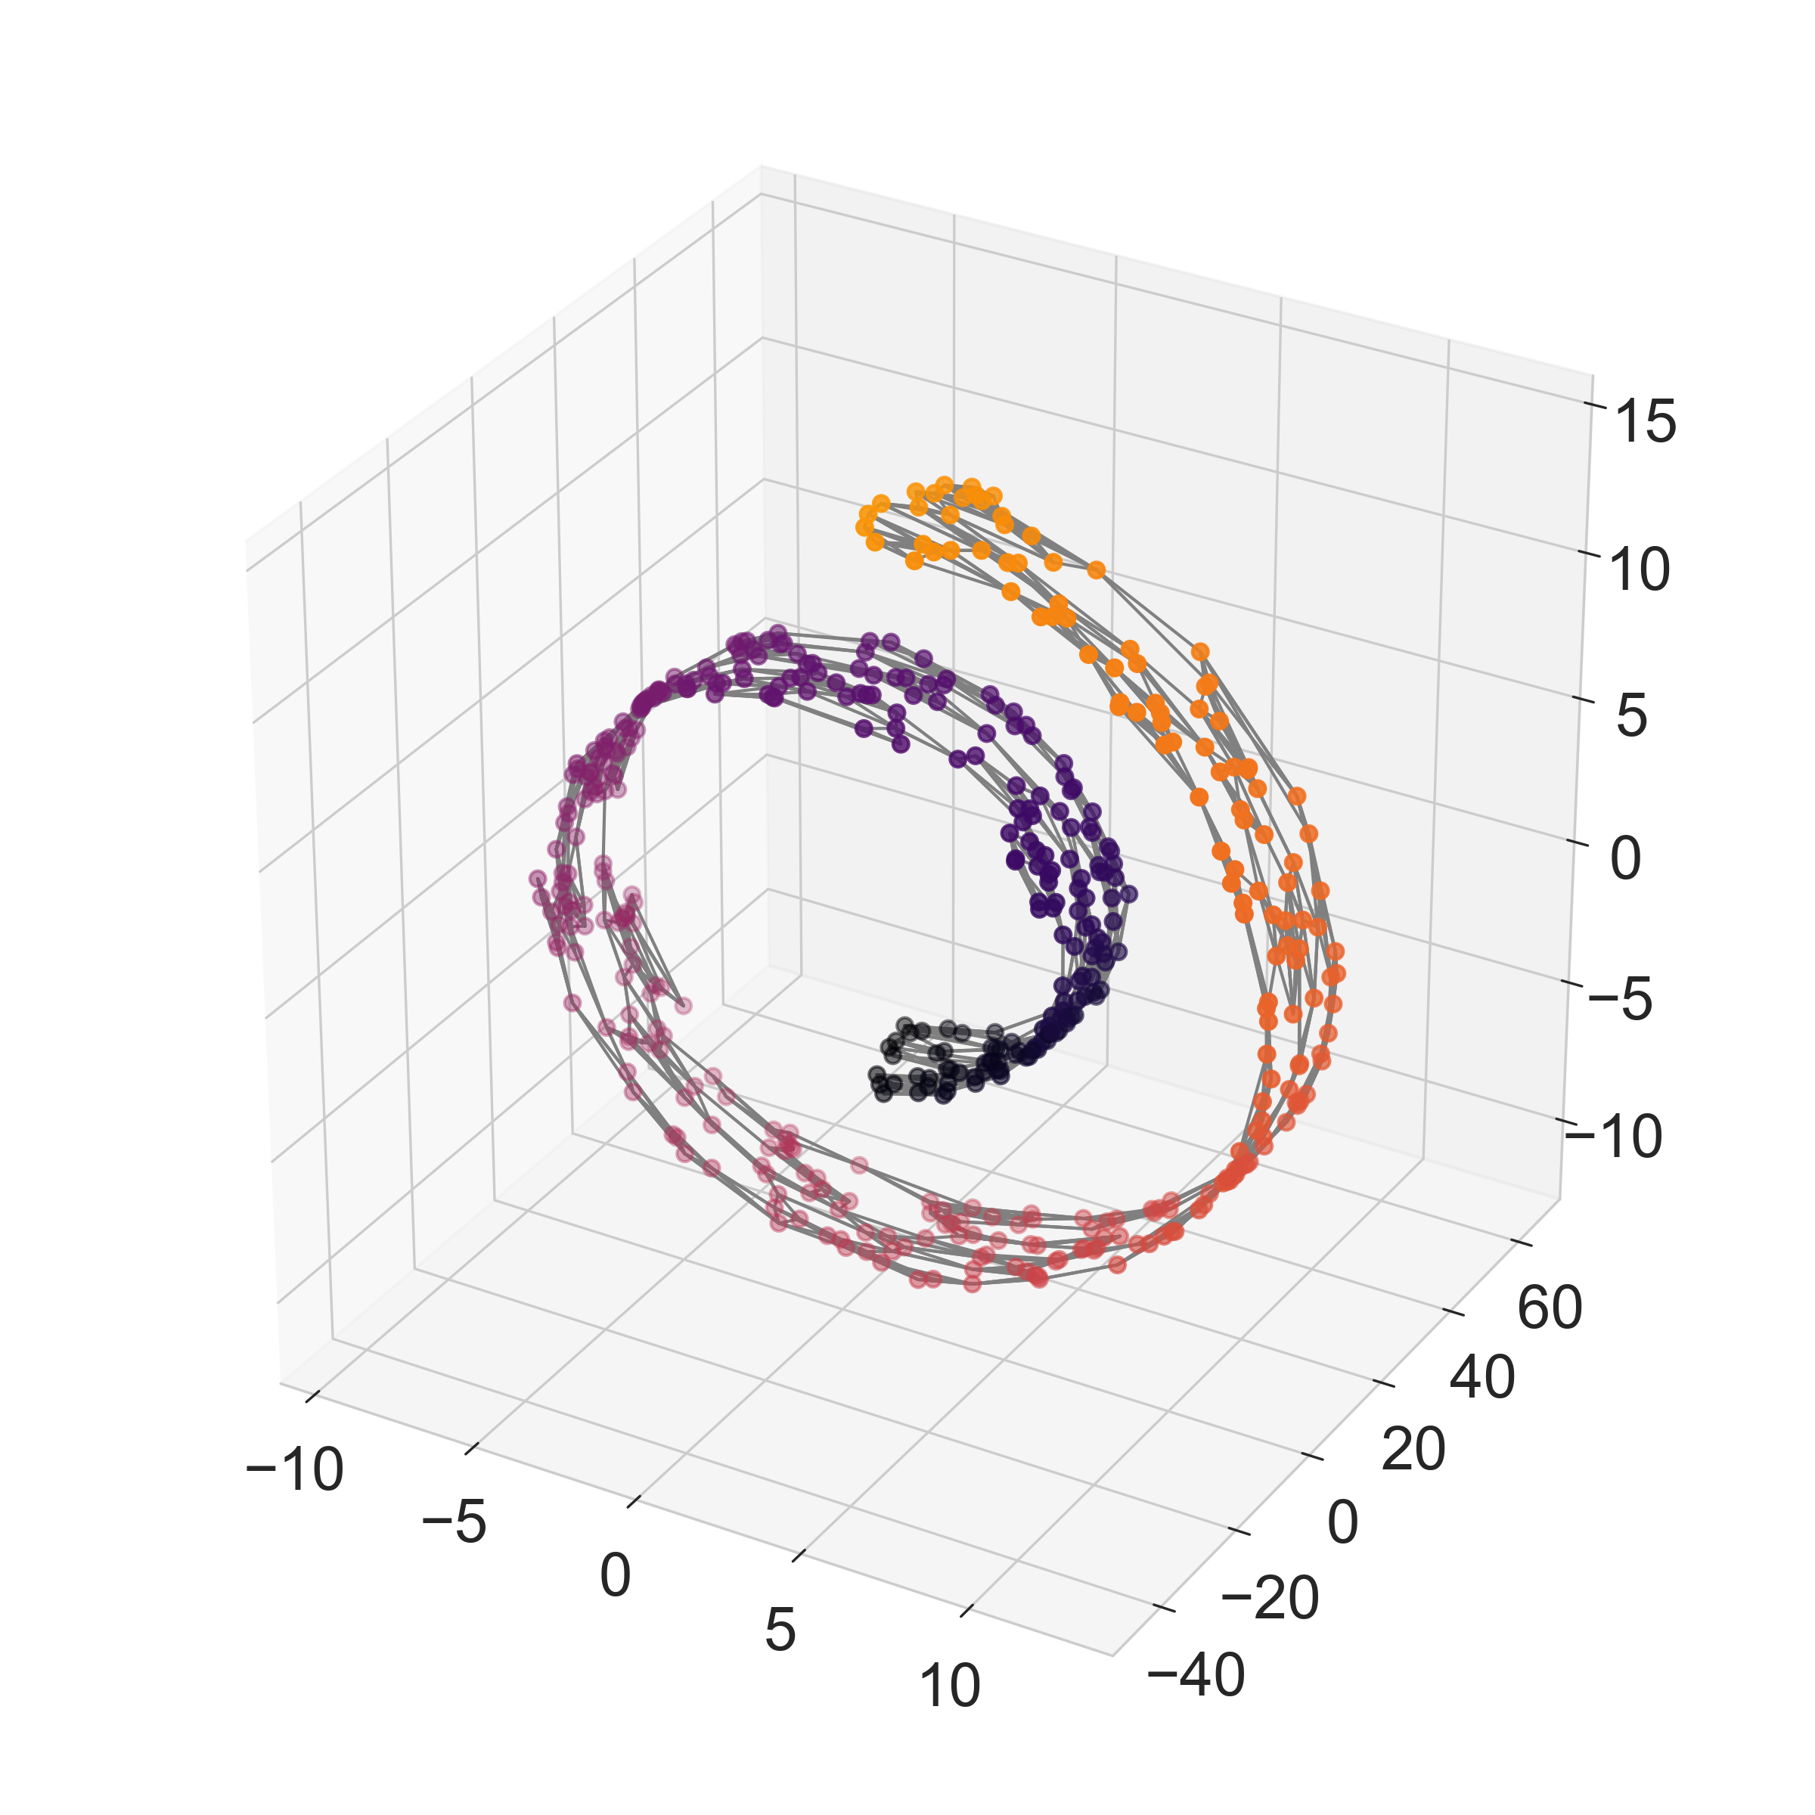
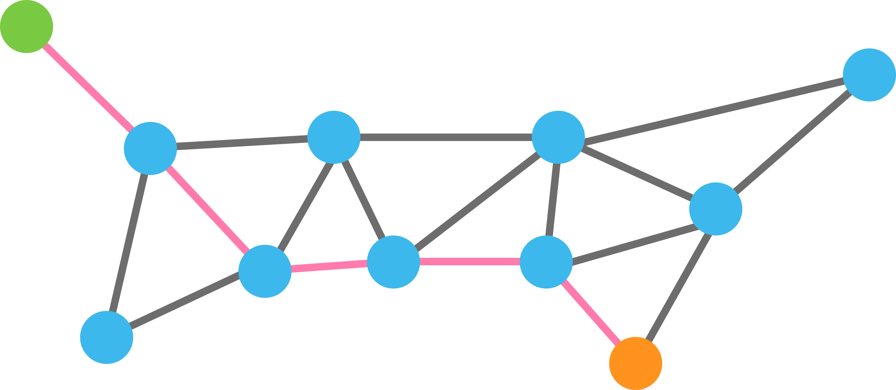
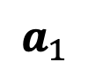
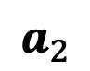
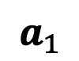
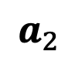
Paths or “walks” on graphs reveal dominant data manifold directions
Shortest path between points
$$a_{1}$$
$$a_{1}$$
$$a_{2}$$
$$a_{2}$$

Slide 5

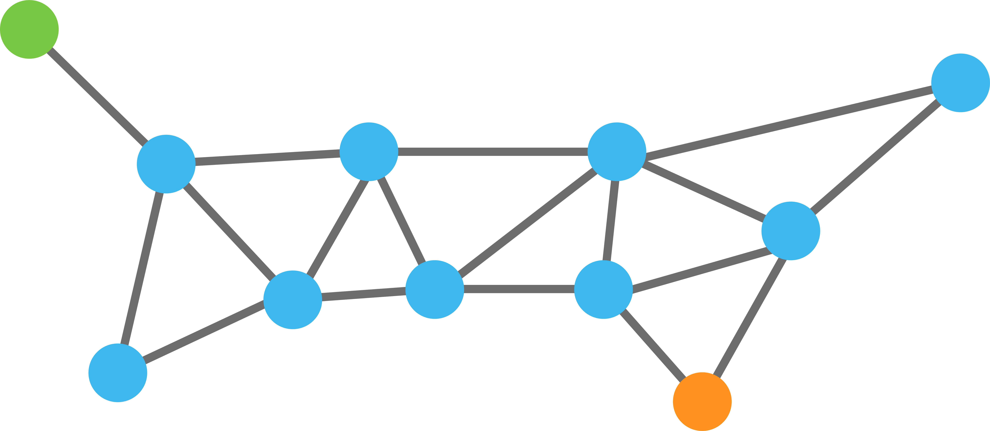
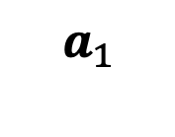
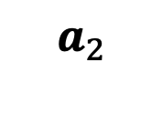
Paths or “walks” on graphs reveal dominant data manifold directions
$$a_{1}$$
P=1
$$a_{2}$$

Slide 6
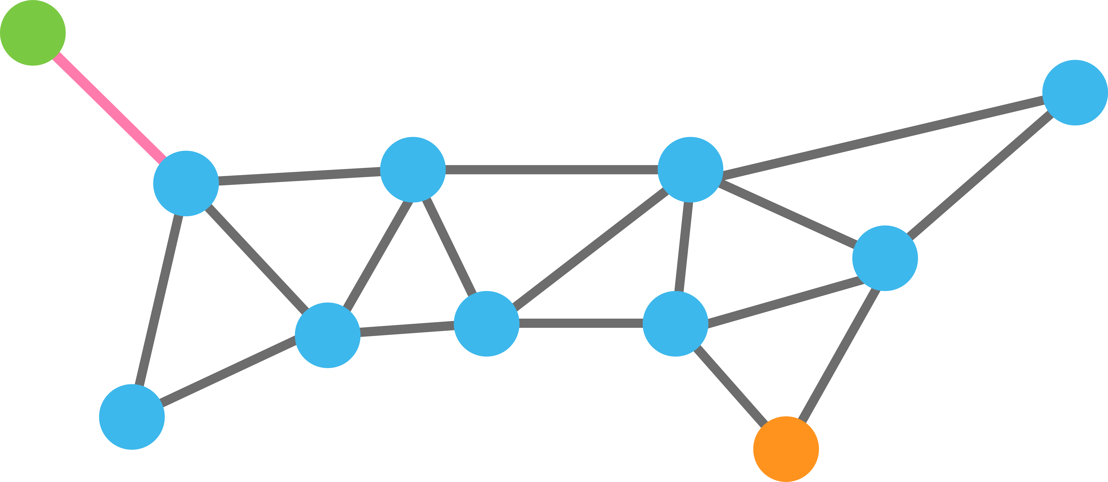
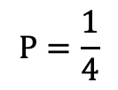
Paths or “walks” on graphs reveal dominant data manifold directions
$$a_{1}$$
$$P=\frac{1}{4}$$
.25
.25
.25
$$a_{2}$$

Slide 7

Paths or “walks” on graphs reveal dominant data manifold directions
$$a_{1}$$
.25
.25
.25
.25
$$a_{2}$$

Slide 8

Paths or “walks” on graphs reveal dominant data manifold directions
$$a_{1}$$
.2
.2
.2
.2
.2
$$a_{2}$$

Slide 9

Paths or “walks” on graphs reveal dominant data manifold directions
$$a_{1}$$
$$a_{2}$$
Steps = 5

Slide 10
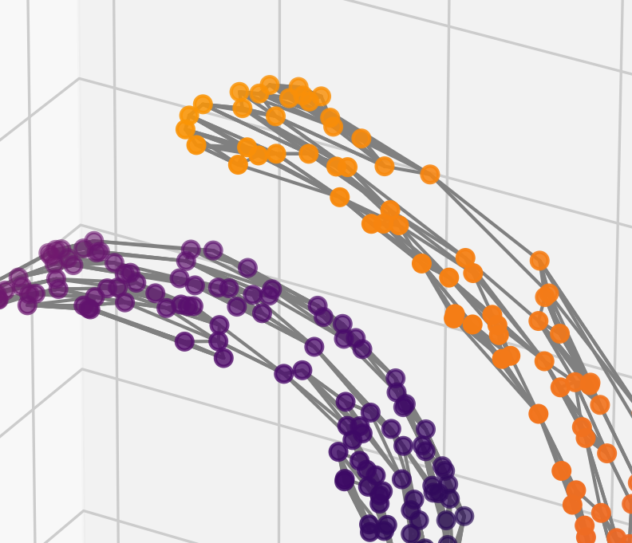
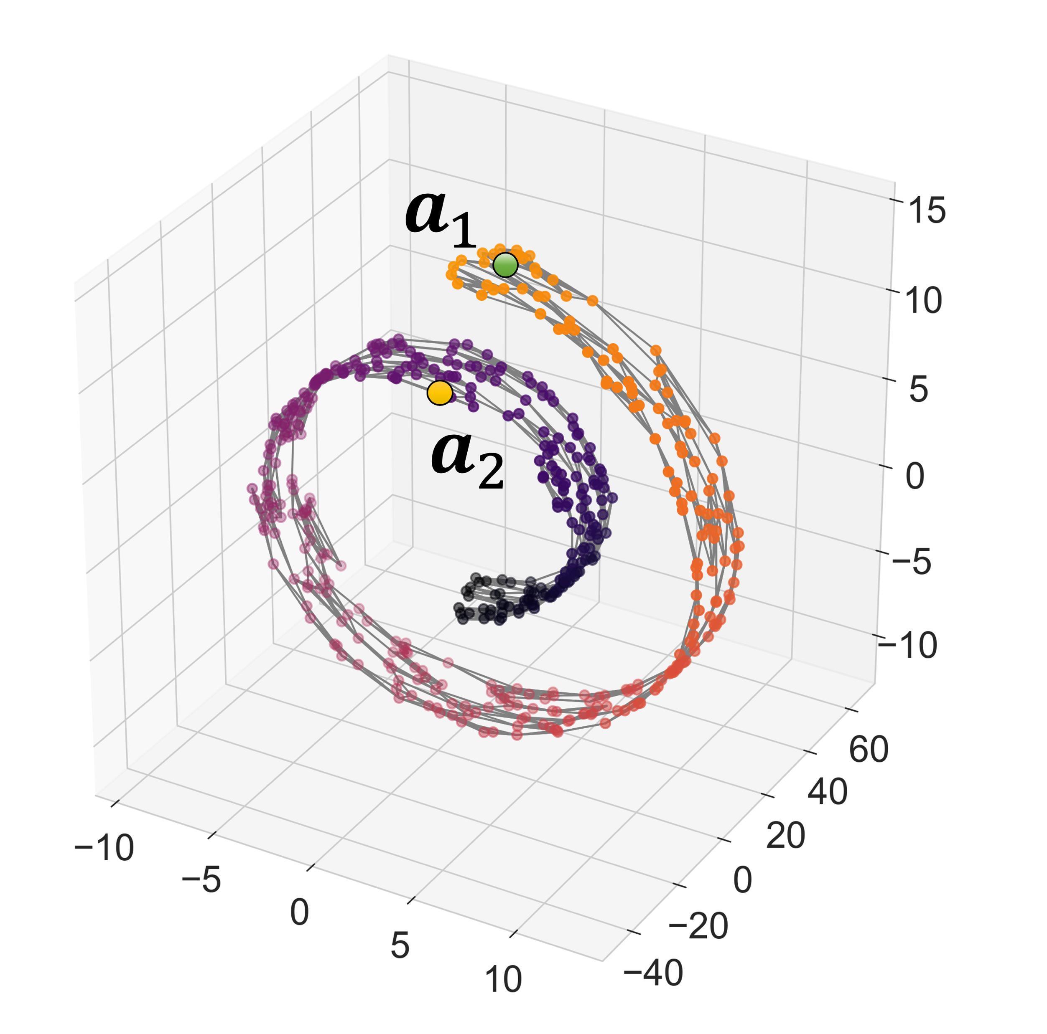
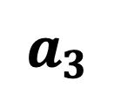
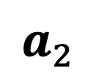
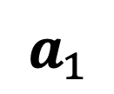
$$a_{1}$$
$$a_{3}$$
$$a_{2}$$

Slide 11
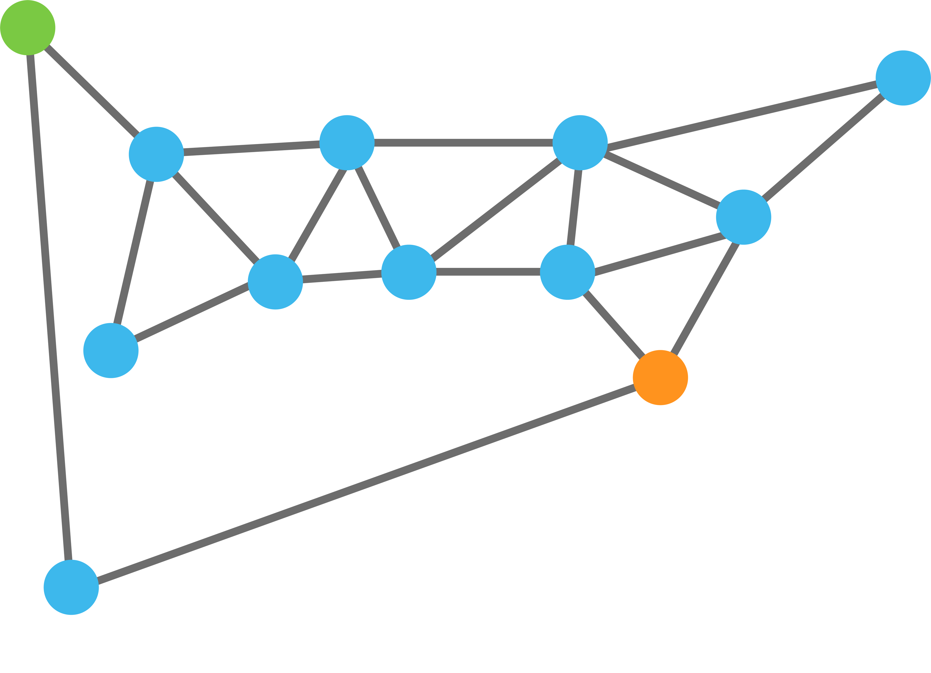
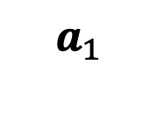
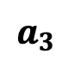
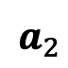
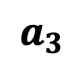
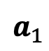
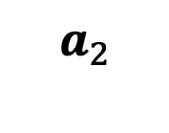
$$a_{1}$$
$$a_{1}$$
$$a_{3}$$
$$a_{2}$$
$$a_{2}$$
$$a_{3}$$

Slide 12
$$a_{1}$$
.9
$$a_{1}$$
.1
$$a_{3}$$
$$a_{2}$$
$$a_{2}$$
$$a_{3}$$

Slide 13
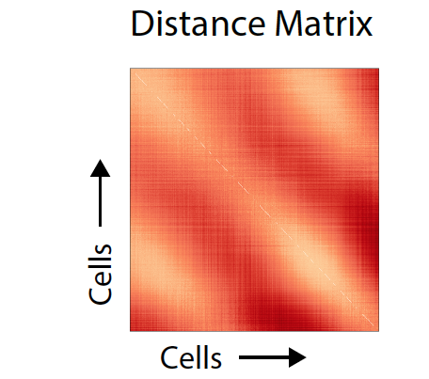
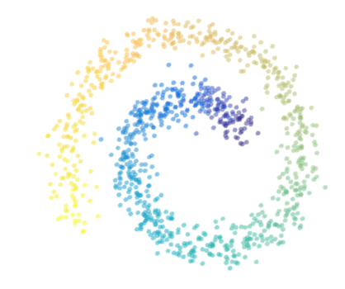
Distance Matrix
Entries are distances
$$D\left(x_{i},x_{j}\right)=\sqrt{||x_{i}−x_{j}}||$$

Slide 14
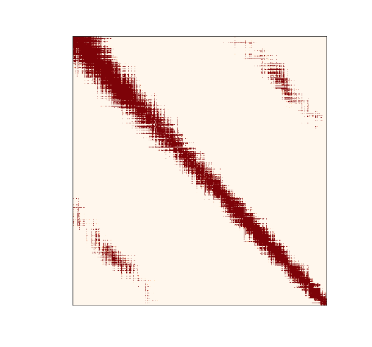
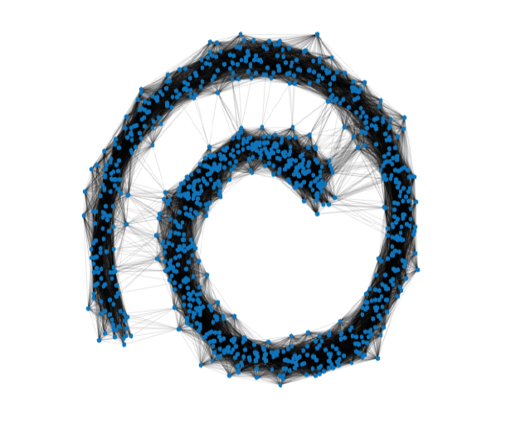
Affinity Matrix
(Gaussian Kernel)
Graph Representation
Entries are affinities
$A\left(x_{i},x_{j}\right)=exp⁡(− \frac{{D(x_{i},x_{j})}^{2}}{σ}$)

Slide 15
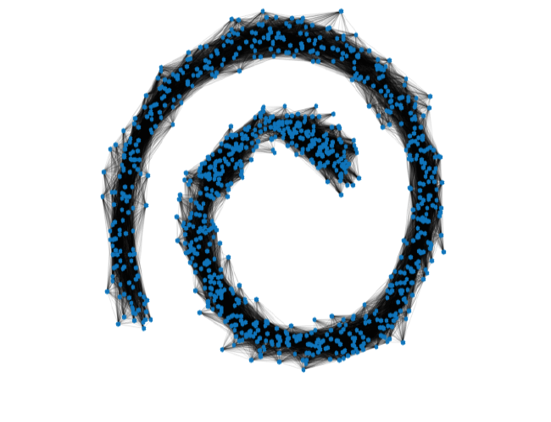
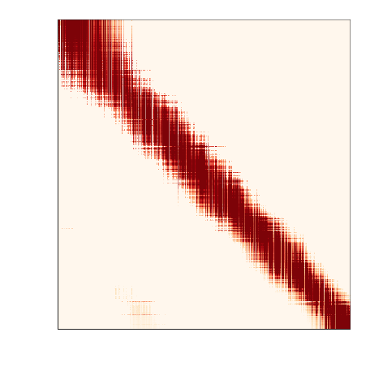
Powered Markov Matrix—Denoises the Affinities (relationship between points)
Powered Markov Matrix
Entries are row normalized affinities
M$\left(x_{i},x_{j}\right)$=$\frac{A\left(x_{i},x_{j}\right) }{\sum_{j}{A\left(x_{i},x_{j}\right) }}$

Slide 16
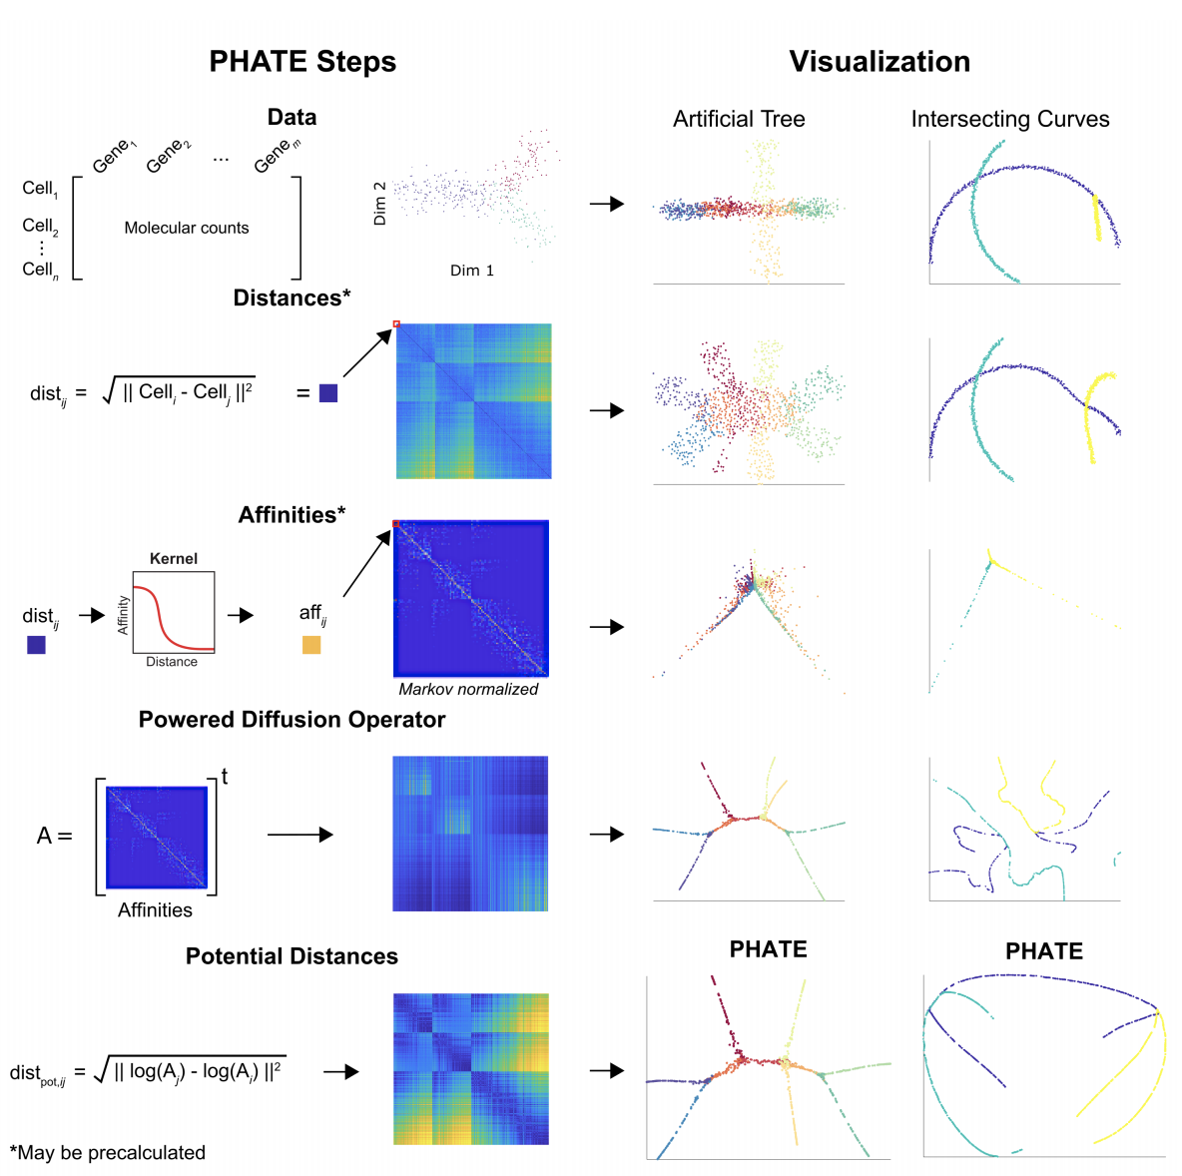
(PCA)
(MDS)
(tSNE)
(DMs)

Slide 17
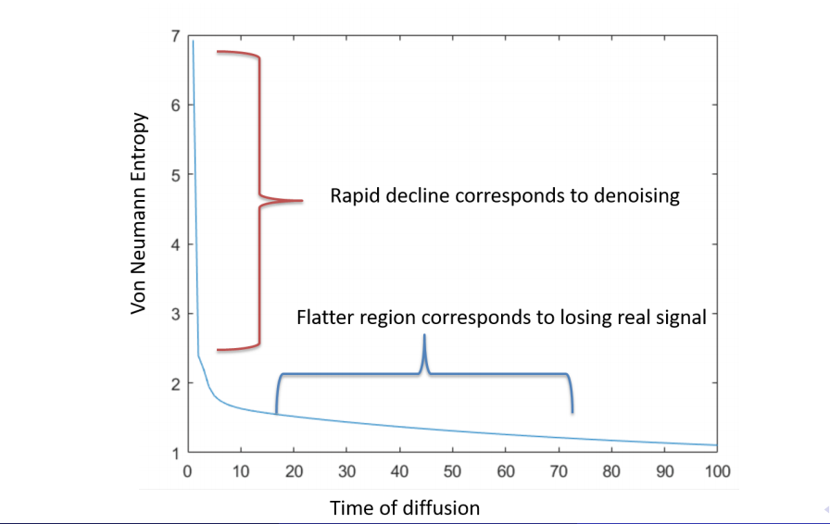
Time of Diffusion t

Slide 18
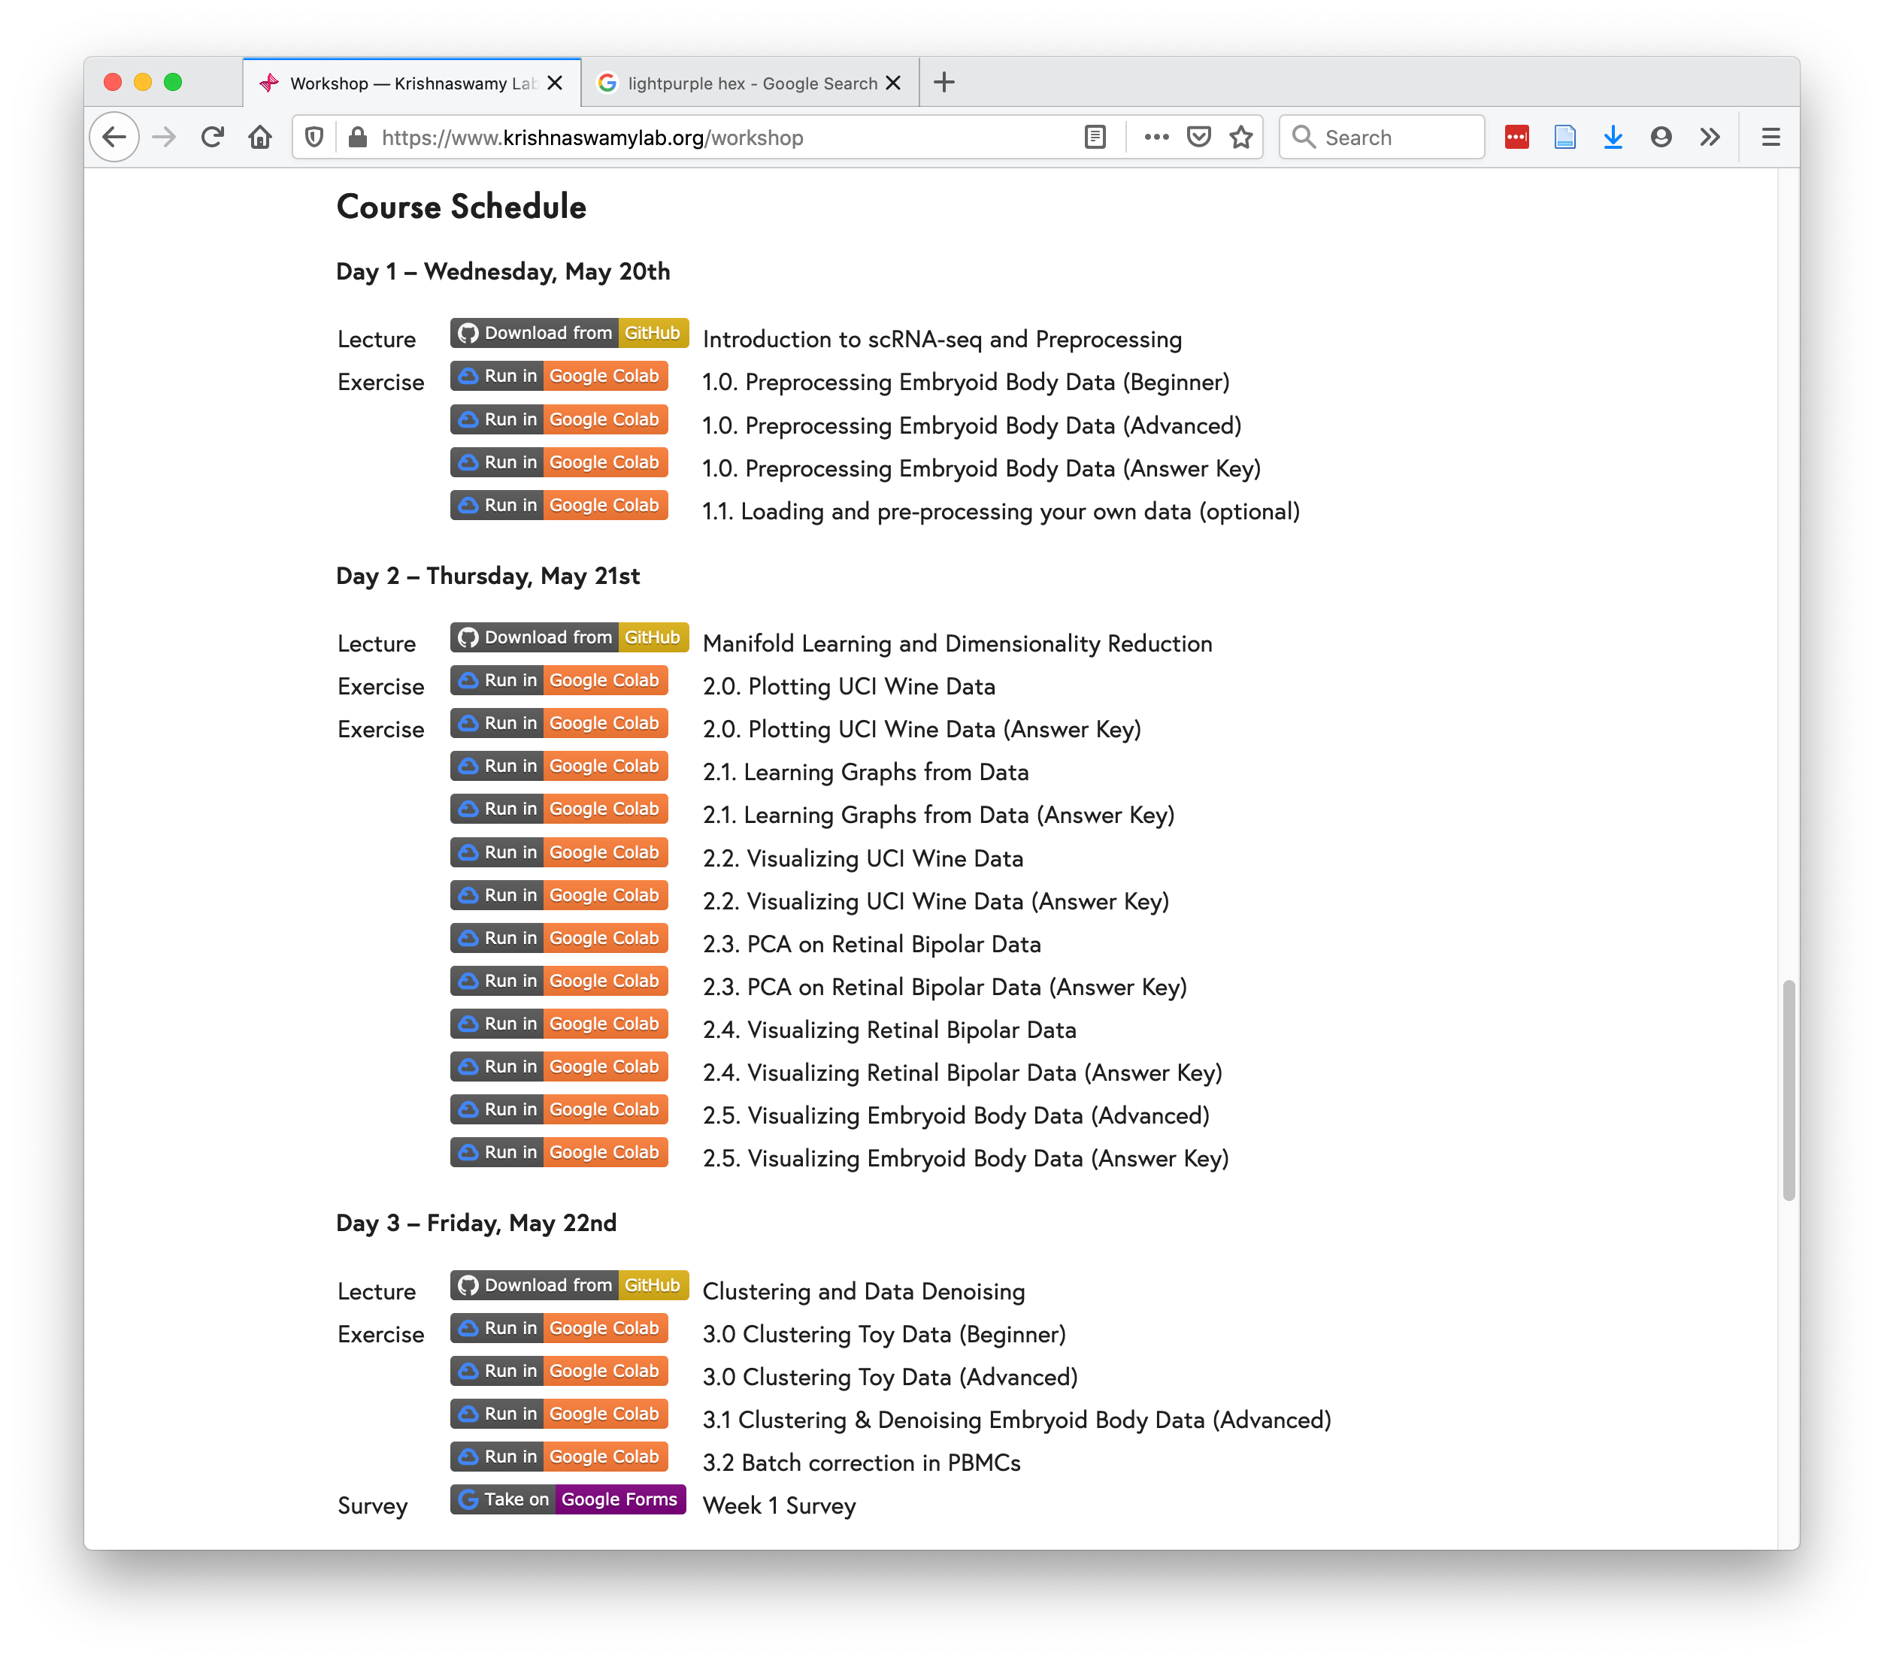
https://www.krishnaswamylab.org/workshop

Slide 19
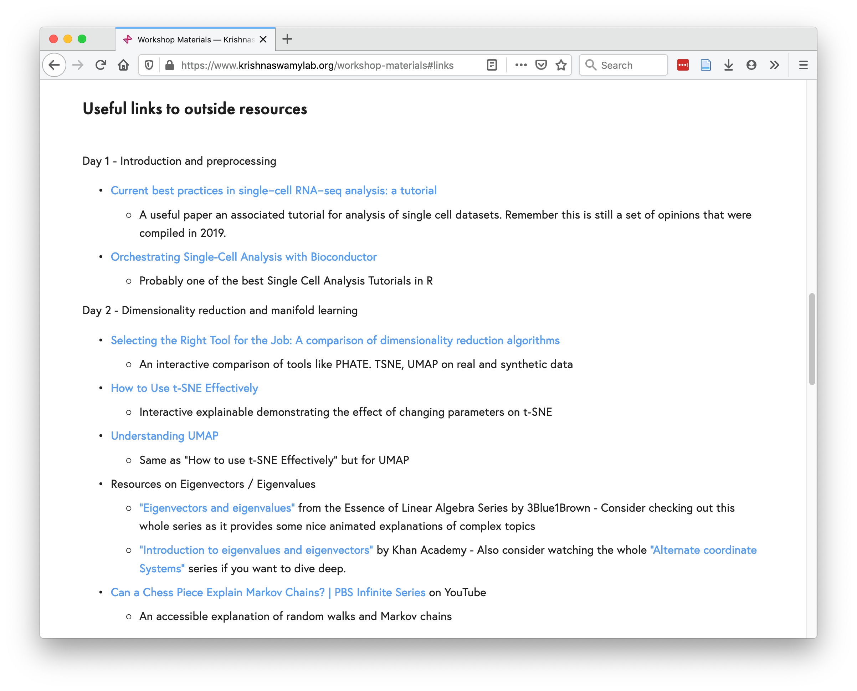
https://www.krishnaswamylab.org/workshop-materials#links

Slide 20
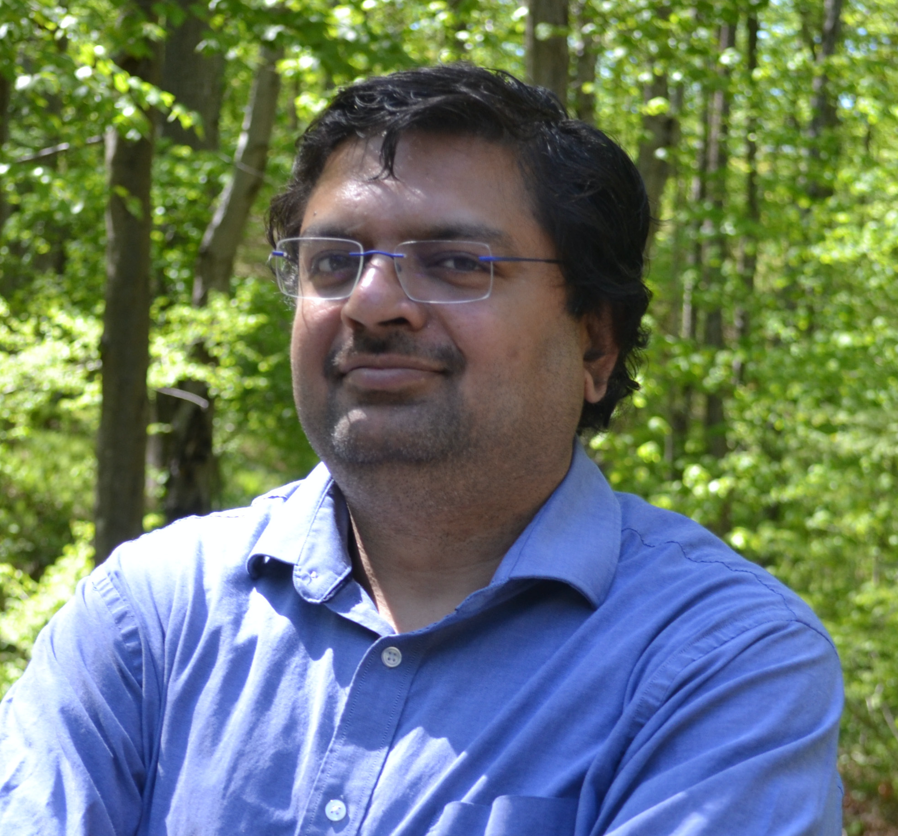



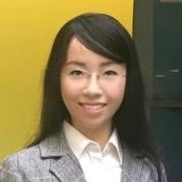






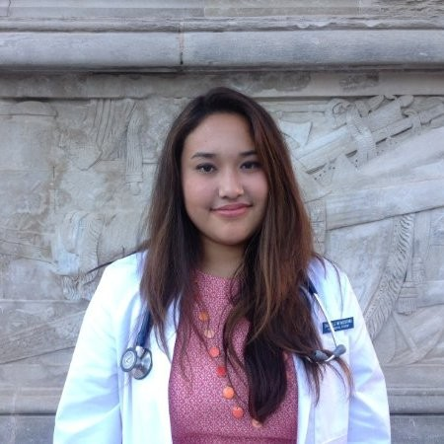



Sameet Mehta, PhD
Daniel Burkhardt
Scott Gigante
Nur-Taz Rahman, PhD
Mamie Wang
Francesc Lopez, PhD
Andrew Benz
Egbert Castro
Wes Lewis
Matthew Amodio
Edel Aron
Danielle Miyagishima
Alexander Tong
Evan Cudone
Aarthi Venkat

Slide 21
@KrishnaswamyLab
#YaleML

Slide 22
Day 3: Denoising, Batch Correction, and Clustering
Notes:
TA introduction
Talk about not teaching code (not a programming workshop)

Slide 23
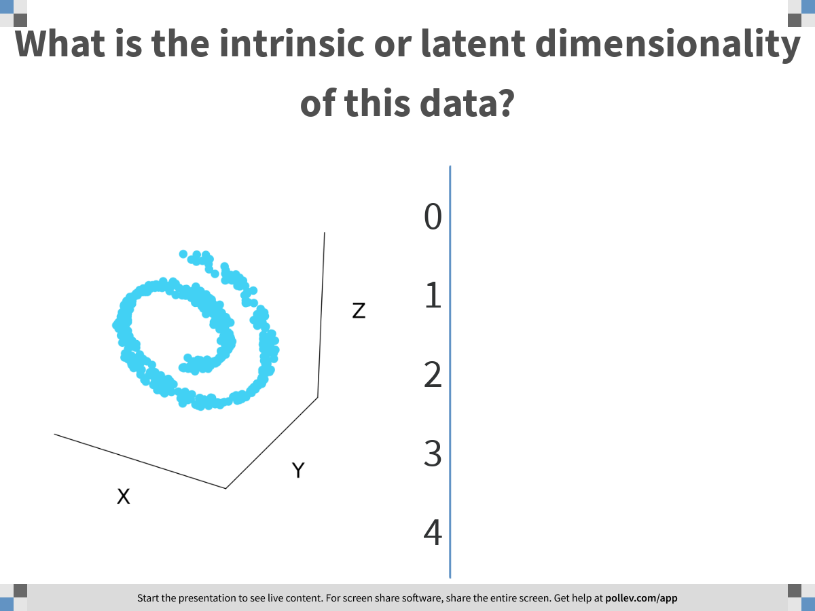
Notes:
What is the intrinsic or latent dimensionality of this data?
https://www.polleverywhere.com/multiple_choice_polls/VuedMRPvKyIBbCuDhPHwO

Slide 24
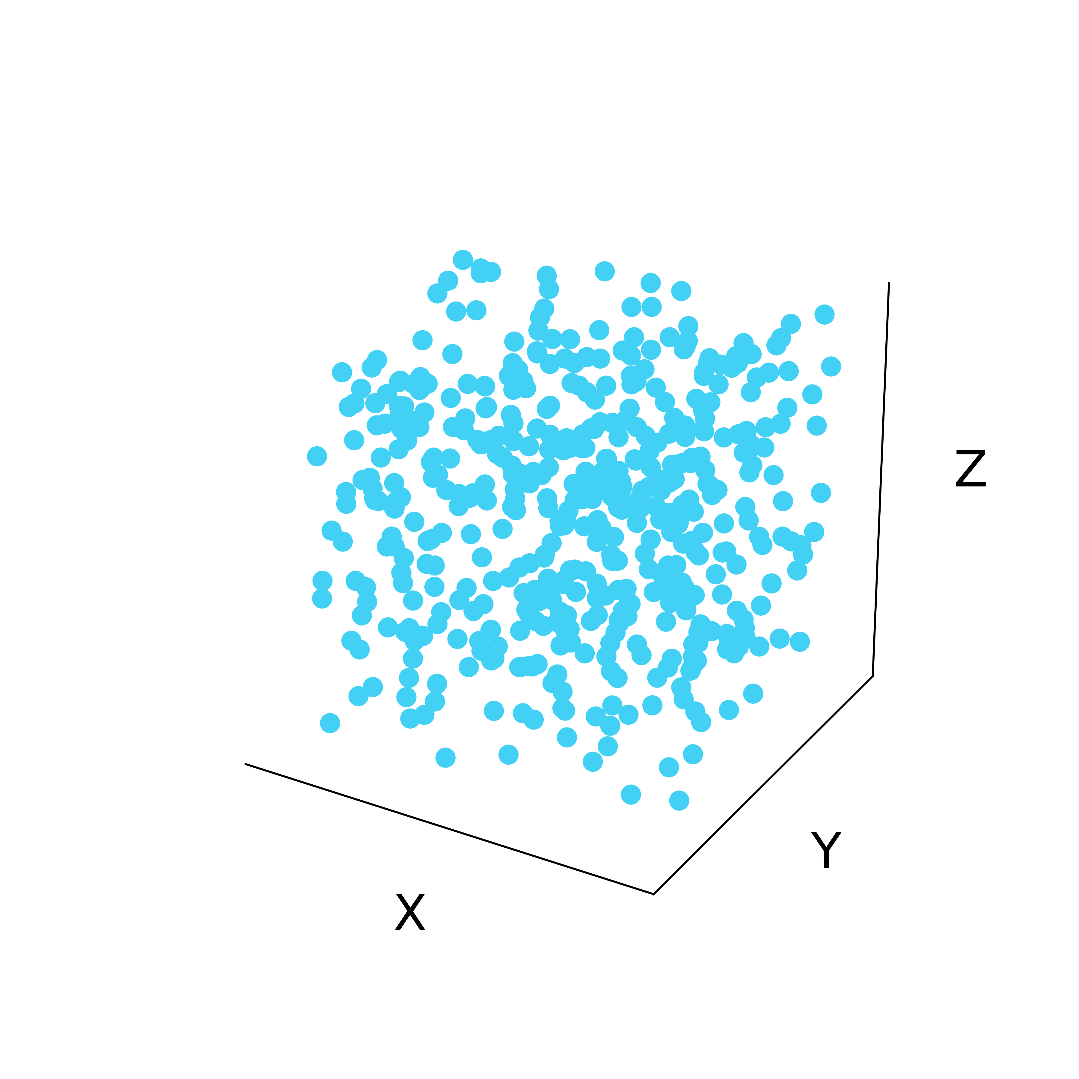
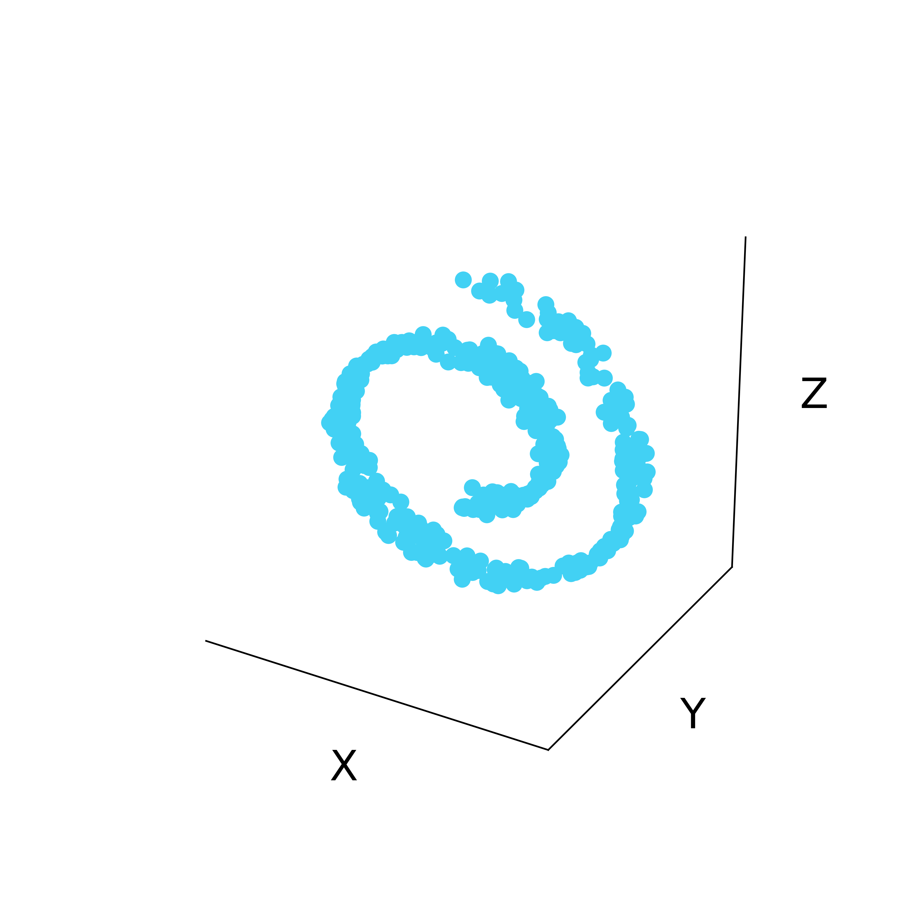
Latent structure in high dimensional data
Low-dimensional
manifold
Ambient Space

Slide 25
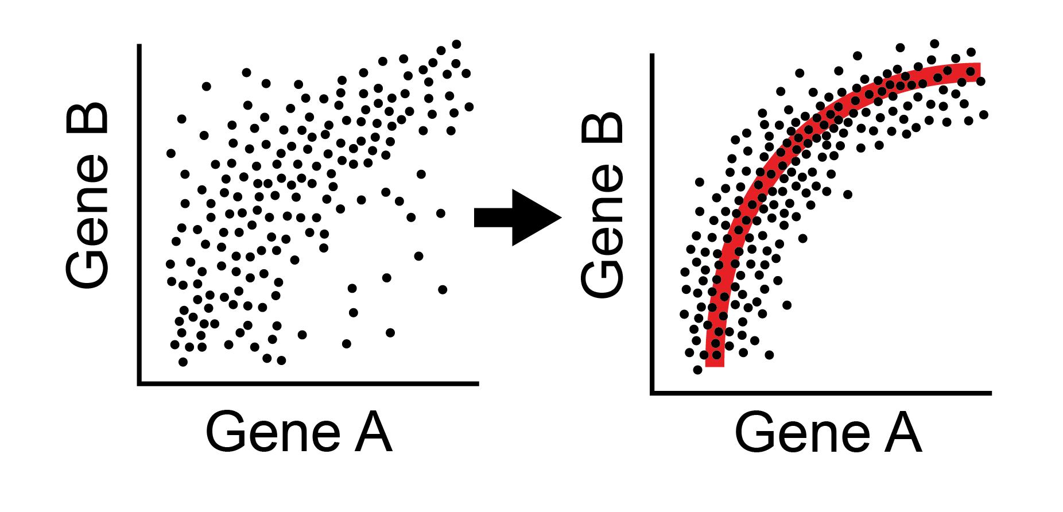
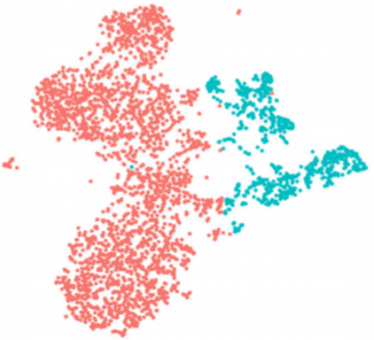
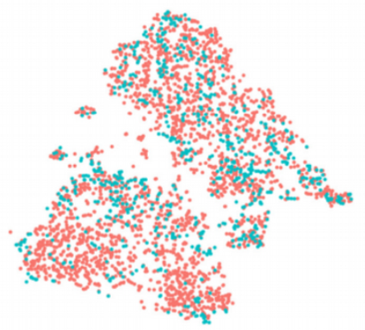
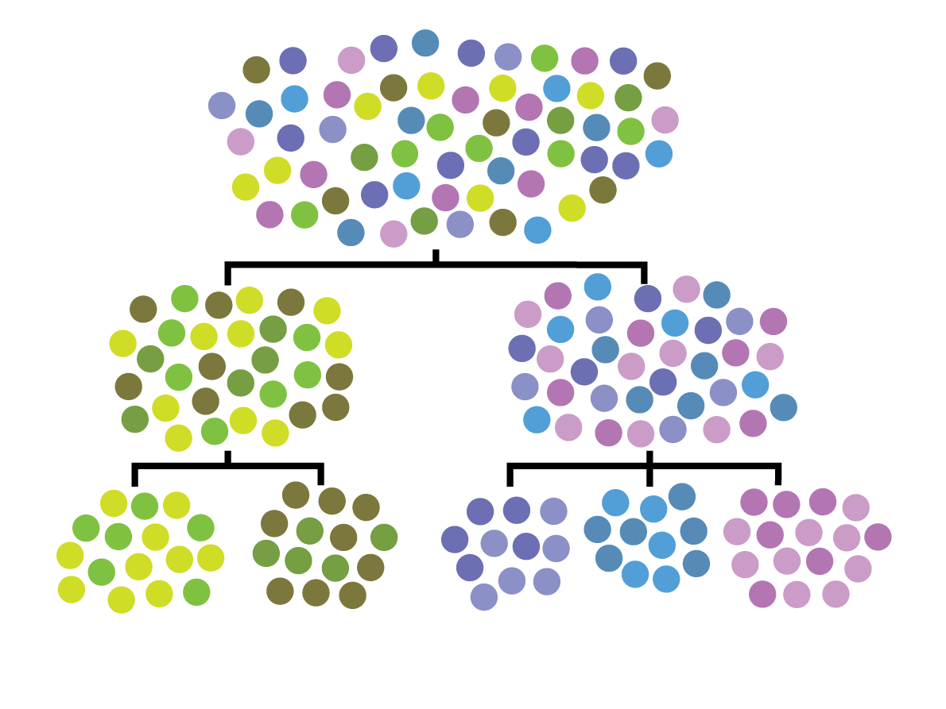
Other uses of affinity matrices, eigenvectors
Data Denoising
Batch normalization
Clustering
Data denoising and batch normalization
Clustering

Slide 26
Using the manifold model to denoise data
Notes:
TA introduction
Talk about not teaching code (not a programming workshop)

Slide 27

Denoising by eliminating dimensions
The number of dimensions in a data that are independent are called RANK
You can denoise data by lowering rank
Noisy image

Slide 28
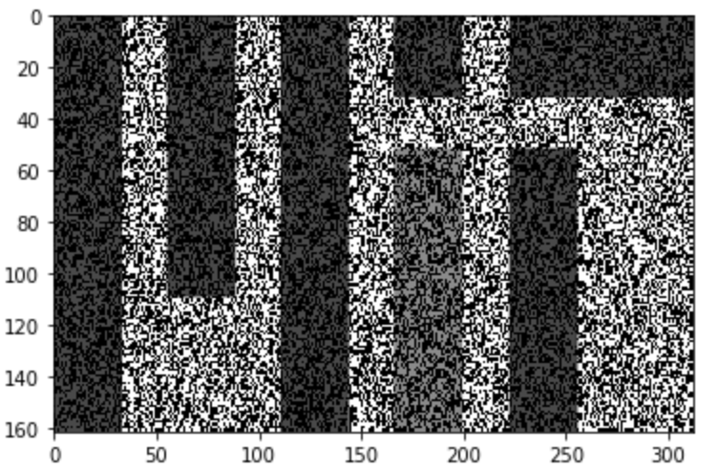
Recreate the data without noise
For this to work you have to have your dimensions be broken up into data dimensions and noise dimensions
Noisy image on the right is broken up into columns and rows instead
What do we do?

Slide 29
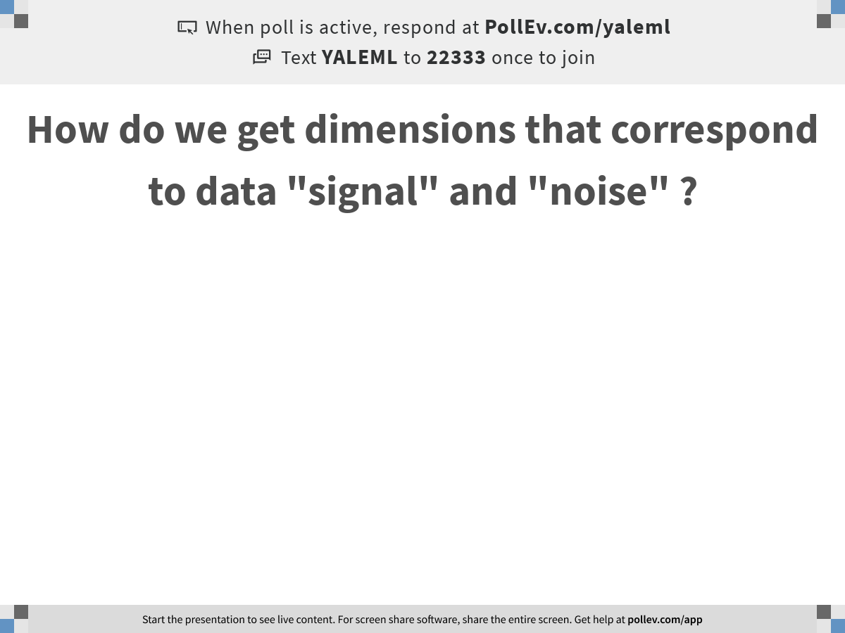
O cor
Notes:
How do we get dimensions that correspond to data "signal" and "noise" ?
https://www.polleverywhere.com/free_text_polls/3OVnyzZchdADfJIdZXVJf

Slide 30
PCA splits signal and noise
The axes with a lot of variation are likely to correspond to data
Axes with little variation correspond to noise directions
The amount of variation captured in each eigenvector is given by its eigenvalue
PC1 will have the highest eigenvalue, captures the most variation ..
PC2 next most
And so on…

Slide 31
SVD: Process similar to Eigendecomposition on non-square matrices
Singular values are eigenvalues of MM* or M*M
Singular vectors are eigenvectors of MM* or M*M
For a mean centered feature matrix the singular vectors U are also PCs

Slide 32
Low Rank approximation
Eliminate the singular vectors with low singular values and recreate the matrix

Slide 33
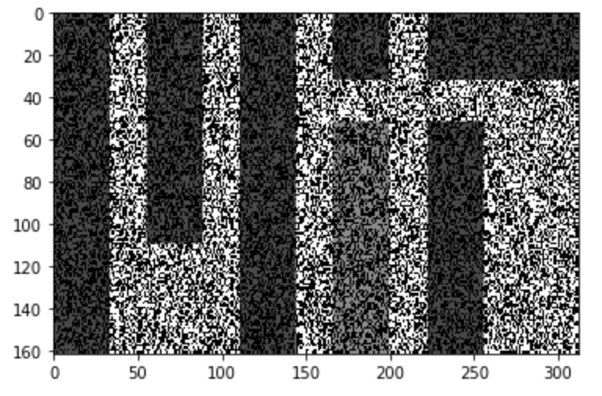
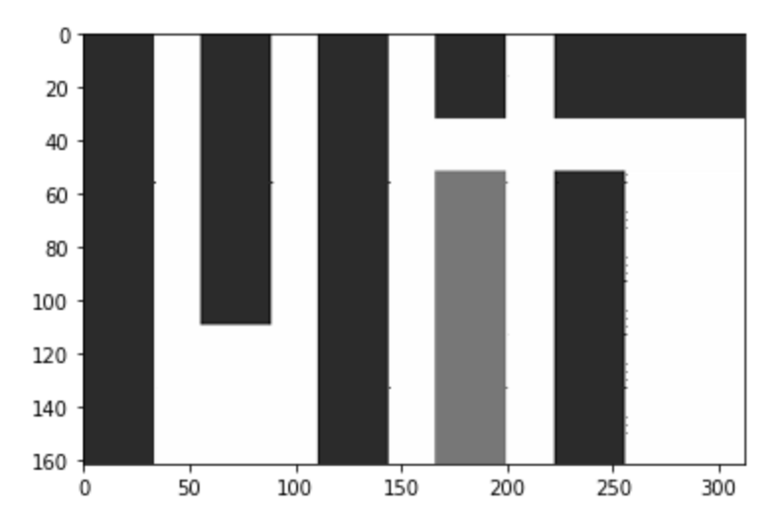
Low Rank Approximation on MIT matrix
Image from https://medium.com/@amelie_yeh/

Slide 34
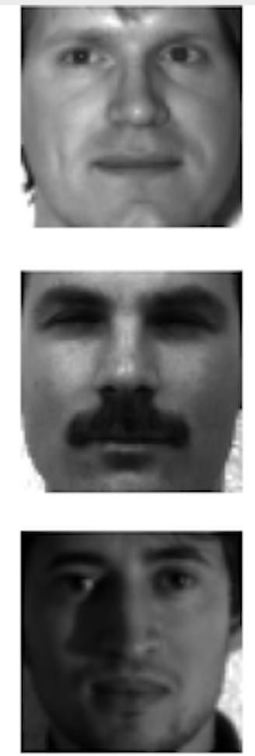


Data is smooth, Noise is jumpy
Can take off noise by taking off low-eigenvalued eigenvectors

Slide 35

Notes:
How many eigenvectors should we use to reconstruct data? How many eigenvectors are noise? How do we know?
https://www.polleverywhere.com/free_text_polls/cCv6DTzZZalEfCgrnKGfB

Slide 36

Eigengap
Jumps in eigenvalues
Might give you a clue

Slide 37



Genes
Cells
Data is noisy and sparse (scRNA-seq)
Notes:
ideally: measure the expression of every gene in every
Samples only a small part of the transcriptome per cell
-- Tens of millions of individual measurements

Slide 38

Notes:
Can we use ideas from image denoising to denoise scRNA-seq data?
https://www.polleverywhere.com/free_text_polls/MHGsb8S3NA2p28T4r1NSd

Slide 39

Low rank approximation for non-linear data
Problem with PCA/Single Value Decomposition (SVD): it takes off linear dimensions in data, noise can be along the non-linear data manifold

Slide 40


Slide 41

Eigenvectors of Affinity Matrix

Slide 42





Eigenvectors are frequency harmonics
2nd Eigenvector
10th Eigenvector
2nd to last eigenvector

Slide 43

Cells are nodes, mRNA gene-counts are signals on a graph

Slide 44

Graph Fourier Transform

Slide 45


Slide 46

Notes:
How many eigenvectors should we take off?
https://www.polleverywhere.com/free_text_polls/P7vNDFrwpqLTCQM2o2TgV

Slide 47
MAGIC
Softly filters eigenvectors, down-weights them in a regular scheme rather than totally taking them off
This is called low-pass filtering on the spectrum of the graph

Slide 48


Imputation Step = Smoothing on Graph

Slide 49

Vertex Domain
Smooths signal on graph
Takes weighted average of neighbor

Slide 50

Low pass filter of Eigenvectors

Slide 51




Frequency domain
No Smoothing
T=2
Kills high frequency
noise
T=5
T=100

Slide 52

missing values
original data with dropout

Slide 53

imputation with MAGIC

Slide 54

imputation with MAGIC

Slide 55

imputation with MAGIC

Slide 56

imputation with MAGIC

Slide 57

imputation with MAGIC

Slide 58

imputation with MAGIC

Slide 59

What t should we choose?
Separate “learning phase” from “stable phase”, quit when data stabilizes

Slide 60

Molecular Validation
https://www.biorxiv.org/content/10.1101/786269v1.abstract

Slide 61

MAGIC recovers gene-gene relationships in an artificially dropped-out dataset

Slide 62
Denoising vs Missing value Imputation
Denoising assumes that data has some noise, all entries have noise added to them
Missing value completion methods assume that the existing values are correct and that some values are missing (not measured)
Matrix completion is a way of filling in missing values
There is some literature in the single cell world trying to differentiate between true zeros and false zeros
People disagree on how this should be done
With a denoising viewpoint it is not necessary to distingsuish

Slide 63

Comparing MAGIC to LRA and matrix completion

Slide 64

Notes:
For what tasks is denoising necessary?
https://www.polleverywhere.com/free_text_polls/FdXlmGtYUXmUKXSuYUtCb

Slide 65

Restoring expressions of characteristic markers

Slide 66

GFAP - marker for astrocytes
With MAGIC
Without MAGIC

Slide 67

Understanding Gene Gene Relationships

Slide 68
Summary of data denoising
Diffusing or smoothing values over a graph can denoise data
This kind of denoising is similar to averaging expression values across neighbors
More diffusion = more denoising
What questions do you have?
Please submit on Slack

Slide 69
Batch correction
Notes:
TA introduction
Talk about not teaching code (not a programming workshop)

Slide 70
Batch Effects in Single Cell
Systematic, non-biological differences between samples due to measurement conditions
Differences could be due to ambient conditions (temperature, humidity), machine calibration, differences in titration, bead/antibody batch, etc
Sometimes refers to actually actual biological differences but those that are “uninteresting” (background demographics rather than immediate drug effect).

Slide 71

Problem with Batch Effect
Samples become hard to compare
All genes, cell types seem different!

Slide 72
How do we detect batch effect?
Visualization!

Slide 73


Diversity Measures
Diversity measures including Shannon entropy have been used to quantify the degree of “mixture” between samples
kBet [Buttner et al] compare global population proportions to local
A priori, we don’t know what the degree of mixture should be, but if batch correction works, it should increase

Slide 74

Batch Correction
Take off artifactual variation and keep biological variation!

Slide 75

Can we use PCA to correct batch effect?

Slide 76

Notes:
How could we use PCA or SVD to remove batch effect?
https://www.polleverywhere.com/free_text_polls/A8BHLXdXtwjBoRMpT3G0E

Slide 77

This noise is large scale
Could be potentially addressed by removing first PC

Slide 78
Problem with PCA
It can address a linear shift in the data
But cannot handle more complex non-linear effects

Slide 79

Cannonical Correlation Analysis
CCA : uses a variant of PCA that brings two sets of samples to a common space
Can cluster or perform other analysis in common space but cannot go back to original space
Finds linear axes of common variation
Thrown off by non-matching populations

Slide 80

Harmonic Alignment
Aligns the diffusion components of two datasets using a rigid rotation that maximizes
correlation of gene loadings onto eigenvectors
Simple rotation does not seem to handle all cases

Slide 81
Mutual Nearest Neighbors
Creates a graph between two datasets
Nearest neighbors in the other dataset could be “matching cells”
But they have to be mutual!
Mutual neighbors
Non-mutual neighbors

Slide 82

Mutual Nearest Neighbors
Use MNNs to find out the direction of the batch effect and correct it.

Slide 83
MNN with MAGIC
B1
B2
Within 1
From 1->2
From 2->1
Within 2
Uses softer affinity matrix and pulls the data in to correct the result

Slide 84


Slide 85
MNN with MAGIC Correction

Slide 86

Notes:
Is mutual nearest neighbor (MNN) normalization linear or non-linear?
https://www.polleverywhere.com/multiple_choice_polls/mnsSK1uYGDPag7UUXFzhc

Slide 87
Summary of data denoising
Batch effects are sample-specific changes in measurements
The goal of batch-normalization is to align cells of the same “type” across samples
Mutual nearest neighbors (MNN) normalized batches by matching cells that are both close to each other
What questions do you have?
Please submit on Slack

Slide 88
Clustering
Notes:
TA introduction
Talk about not teaching code (not a programming workshop)

Slide 89

The human body comprises untold cellular diversity
High Degree of Complexity
Roadmap Epigenomics Consortium Nature 2015
Notes:
The number of cell types is QUANTITY for which ONLY ESTIMATES.
“List of distinct cell types in the adult human body” ~220 cell types.
Is this number essential?
May seem obvious, but defining CELL TYPE precisely, is not straight forward, open to revision
Even looking at just one system, the blood and the bone marrow niche that generates it, still new facets.

Slide 90

Phenotyping in Biology

Slide 91


tSNE Map of Immune Cells
van der Maaten JMLR 2008, 2014
Amir et al. Nat. Biotech 2013
Notes:
This is what we would want to see.
Cell types are well separated
We can see additional structure that is missed by the manual gating

Slide 92


Breast Cancer Subtypes

Slide 93
Clustering Used in Many Ways in Biology
Clustering gene expression profiles to find “modules” or groups of genes that work together
Clustering patient data to see if patients have similar disease
Clustering cells to find different cell types

Slide 94
What is clustering?

Slide 95

Grouping of Similar Objects
Linkage Clustering, Community detection

Slide 96

Density Centers
DBSCAN, Gaussian Mixture Model

Slide 97

Metastable States in A Manifold
PHENOGRAPH

Slide 98

A partitioning of the data space
Voronoi Diagram
K-MEANS (Macloed 1967), Fidduccia Matheyses

Slide 99
How is the partition picked?
By minimizing different objective criteria
Closeness of members within the group
Distance/Separation between groups
Ratio of the two
Minimum cut of an NN-graph
Other criteria?
Modularity: actual edges/ expected edges

Slide 100

https://scikit-learn.org/stable/modules/clustering.html

Slide 101
Conclusions
Clustering algorithms partition data to identify groups of similar observations
Different objectives and different minimizations give rise to different algorithms

